Slide 1
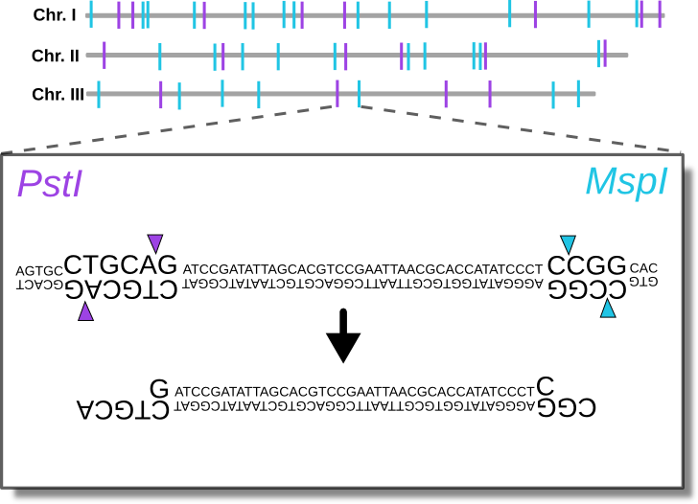
Lab 12: Introduction to RADseq data
BIOL4174/5174 Conservation Genetics Spring 2018

Slide 2
outline
NGS- why reduced-representation
Targeted enrichment vs RADseq
Overview of ddRAD
Overview of Illumina
Potential problems:
Overclustering
Conflicting fluorescence within clusters
Evaluating in FASTQC
Assembling RADseq data: ipyrad
Quality filtering
Clustering within individuals
Catalog generation
Clustering among individuals
Etc.

Slide 3
Next-generation sequencing
Millions of sequences at $0.05 per million bases
Can sequence entire genomes
Whole-genome sequencing often too expensive for population-level (hundreds, thousands of individuals)

Slide 4
Reduced-representation sequencing
To be useful at the population-level, need to reduce the genome consistently across individuals
Most common methods:
Restriction-site Associated DNA sequencing (RADseq)
Targeted enrichment methods

Slide 5
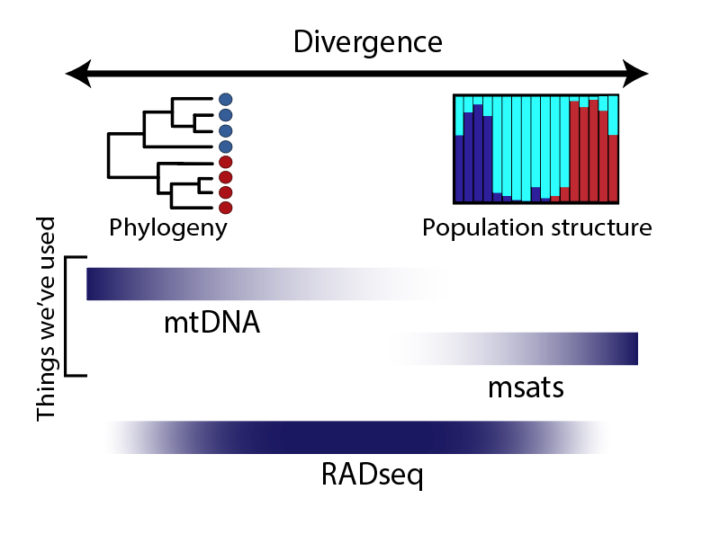

Slide 6
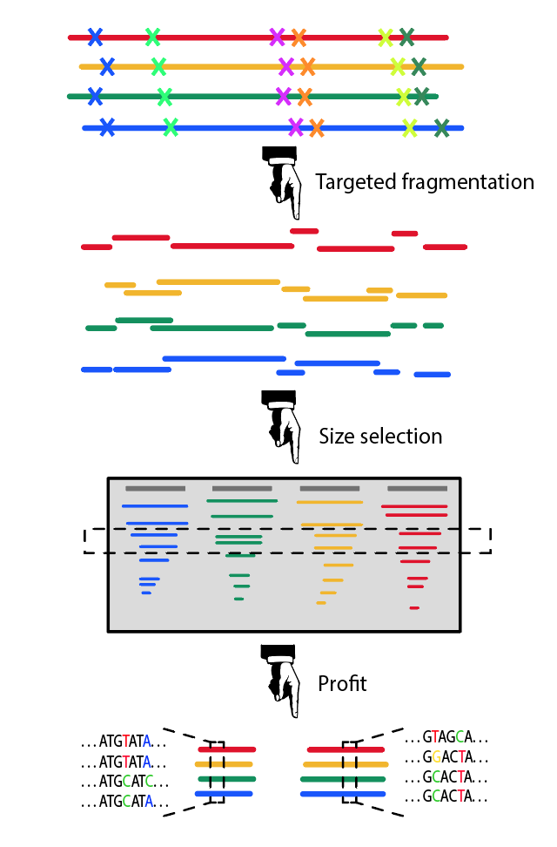
RAD-seq

Slide 7
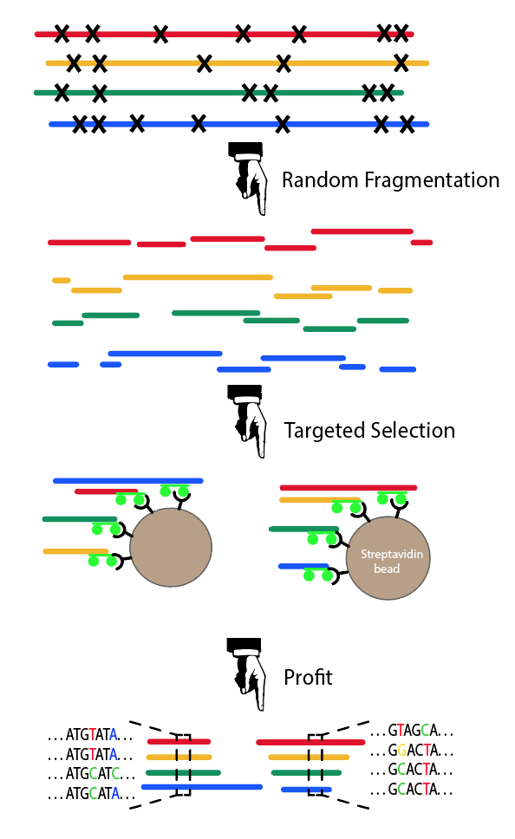
RAD-seq
Targeted Enrichment

Slide 8
1. Digest genomic DNA with paired restriction enzymes
Double-digest RADseq

Slide 9
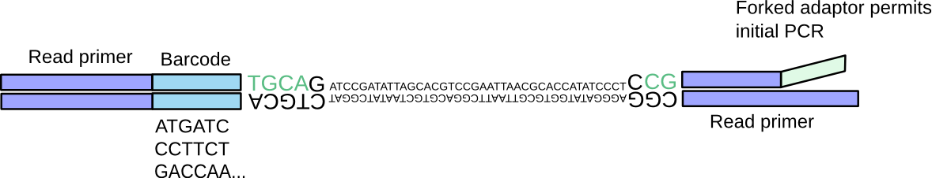
2. Ligation of barcoded adaptors
Double-digest RADseq
Barcoded samples can then be pooled

Slide 10
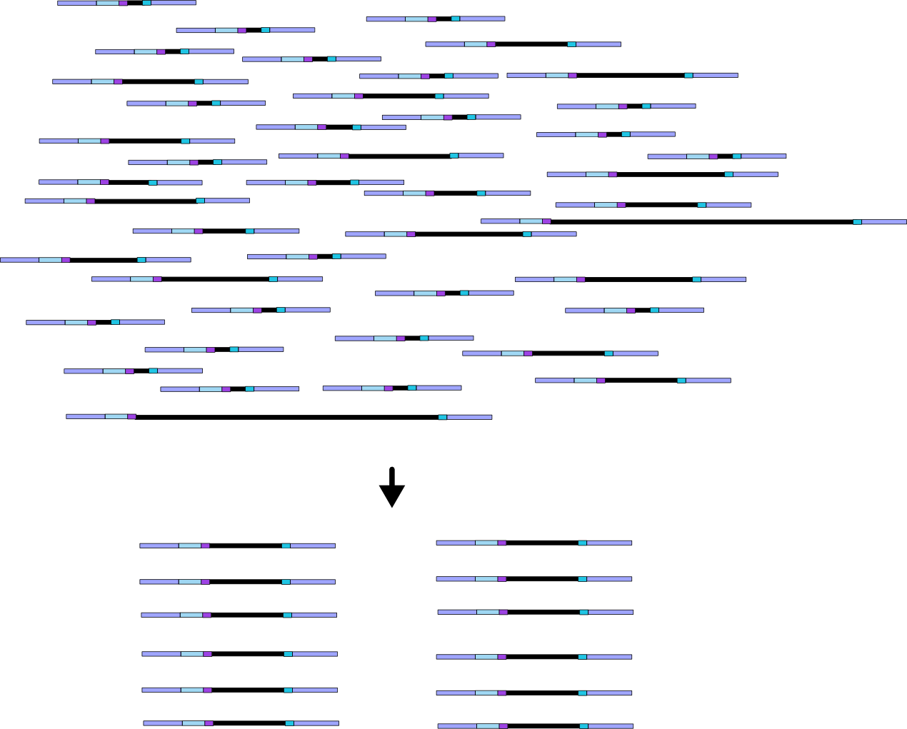
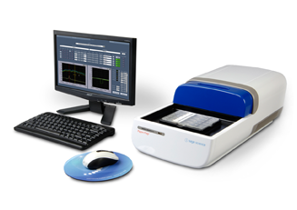
3. Size selection of digested fragments
Double-digest RADseq

Slide 11
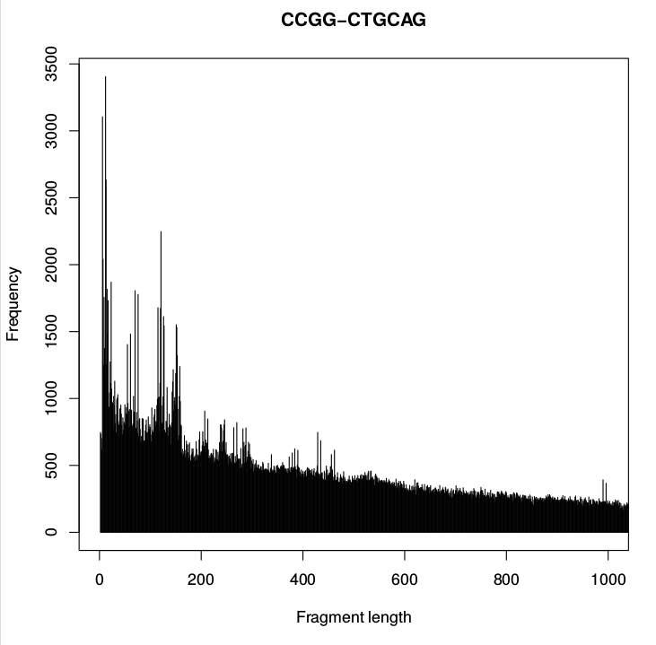
3. Size selection of digested fragments
Double-digest RADseq
Size range manipulated to target specific # of loci

Slide 12
3. Size selection of digested fragments
Double-digest RADseq
Size range manipulated to target specific # of loci

Slide 13
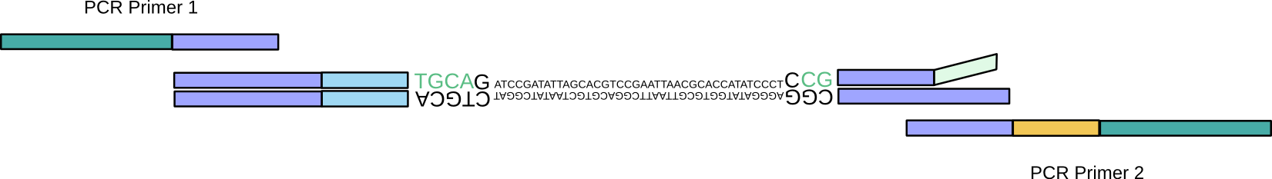
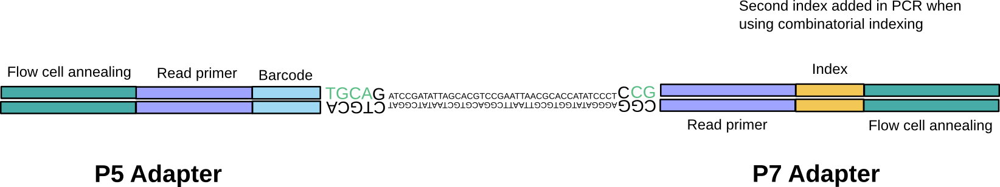
4. Adaptor extension by PCR
Double-digest RADseq

Slide 14
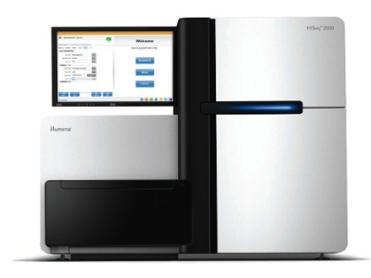
Final library
Double-digest RADseq
P5-P5 and P7-P7 fragments fail bridge amplification and are not sequenced

Slide 15
Illumina Sequencing
https://www.youtube.com/watch?time_continue=1&v=fCd6B5HRaZ8

Slide 16
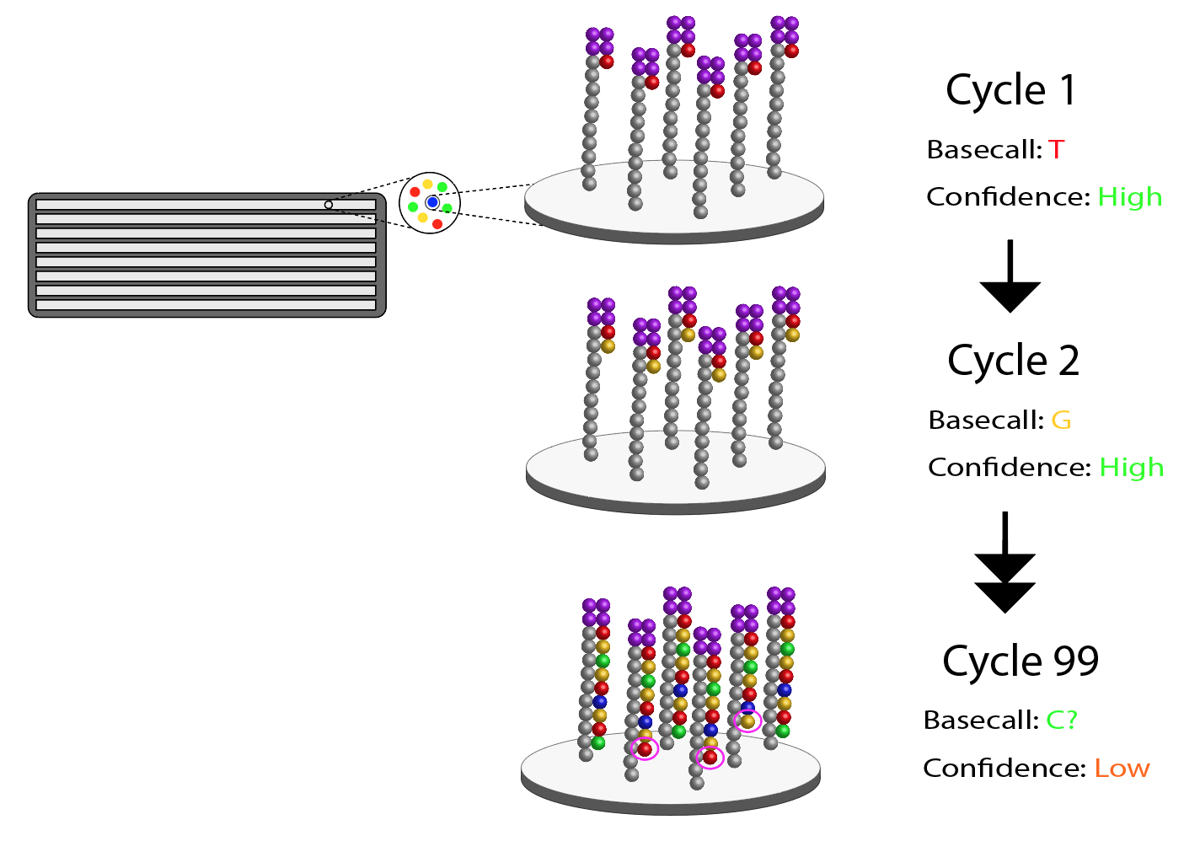
Error increases with cycle number

Slide 17
Error increases with cycle number

Slide 18
Error increases with cycle number

Slide 19
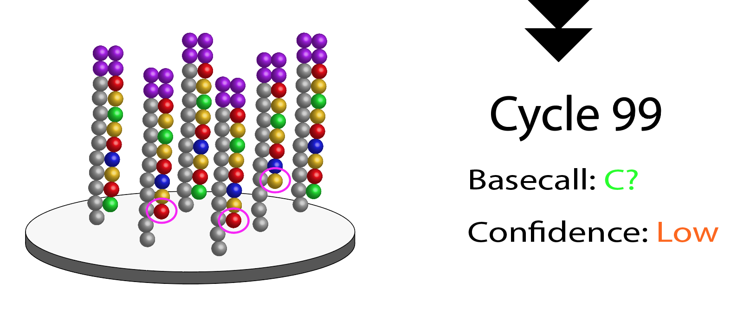
Error increases with cycle number

Slide 20
Error increases with cycle number
“Quality Score” (Confidence)
Position in read (base #)

Slide 21
Reporting confidence: FastQ Format
One of these 4-line blocks for each read!

Slide 22
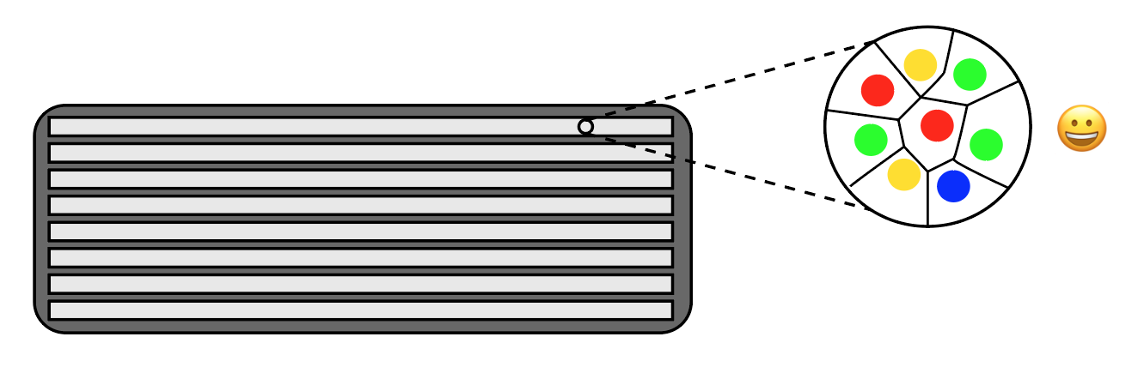
Illumina cluster delimitation
Illumina uses an algorithm to look at patterns of fluorescence in the first ~11 bases to ‘find’ clusters (representing copies of the same template fragment)

Slide 23
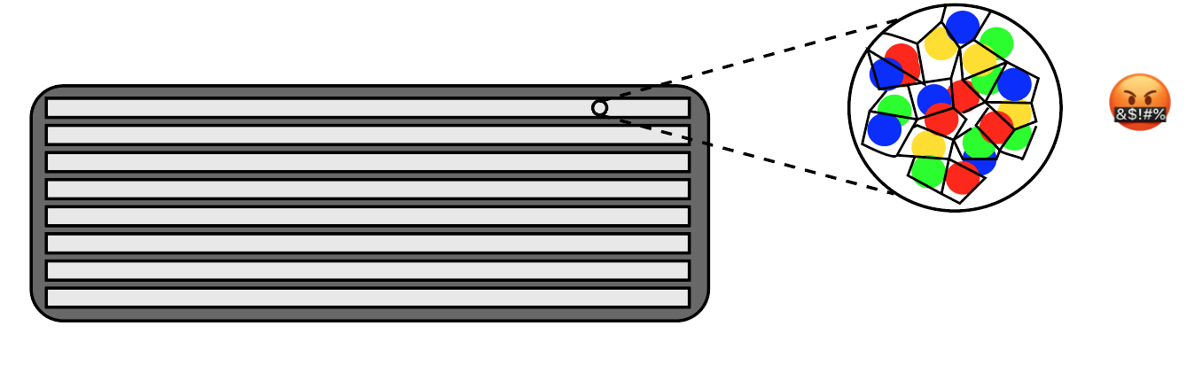
Illumina cluster delimitation
If the flowcell is loaded with too much library, clusters can overlap, confusing the algorithm. This results in many low-confidence base-calls.

Slide 24
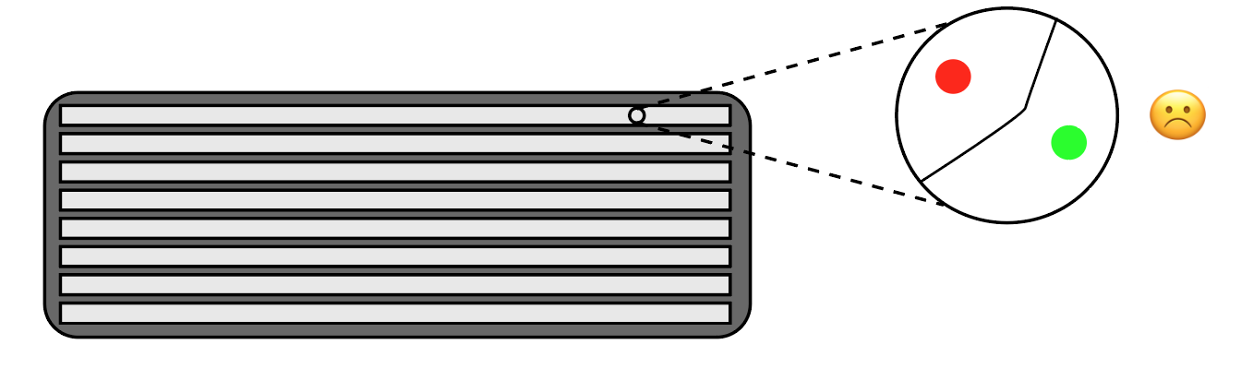
Illumina cluster delimitation
Loading too little library leads to inefficient use of ‘flowcell space’, which means less data (and wasted $$)

Slide 25
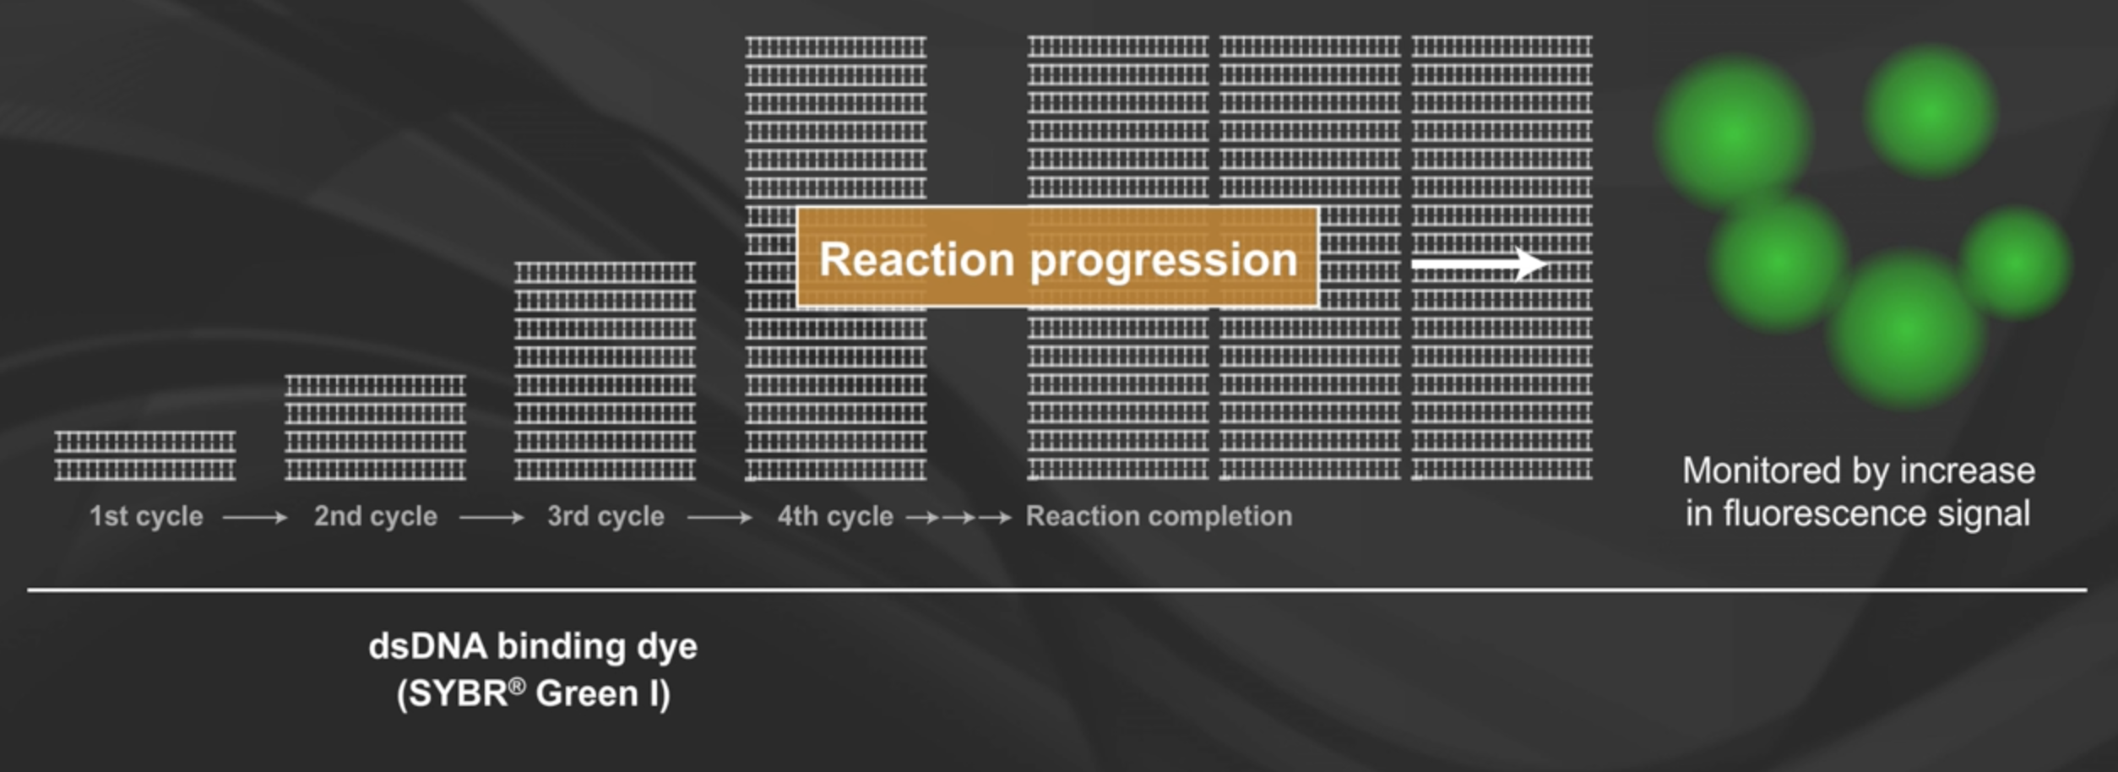
Illumina cluster delimitation
Optimal cluster density requires QC before loading. Generally, the facility will use quantitative PCR (qPCR) to estimate proportion of DNA which is sequence-able

Slide 26
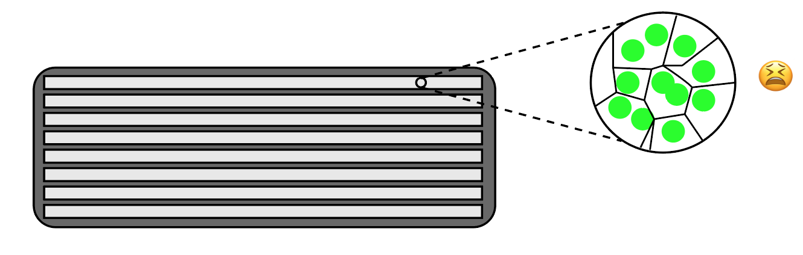
Illumina cluster delimitation
When the library is low-diversity, the algorithm can also have a hard time delimiting clusters. The solution is to add (or ‘spike-in’) high diversity DNA like PhiX viral DNA, which then hast to be removed bioinformatically

Slide 27
Examining per-tile quality in FastQC
RED = BAD
Position in flowcell lane
Position in read (base #)

Slide 28
Assembling RADseq data

Slide 29
A note on dealing with NGS data
The field is moving fast… Often ready-made tools do not exist, so you will have to create them yourself.
This will require programming knowledge…

Slide 30
A note on dealing with NGS data
If you want to be a bioinformatician…
Learn Python…
Or Perl…
Or some other language

Slide 31
Resources on campus to learn to program
These courses are geared towards graduate students with no prior programming experience
BIOL 5153: Programming for Biologists
Andy Alverson
Next offered: Probably Spring 2019
CSCE 3213: Cluster Computing
Pawel Wolinski
Next offered: Probably Spring 2019

